Slide 1

ATHARVA EDUCATIONAL TRUST'S ATHARVA COLLEGE OF ENGINEERING
(Approved by AICTE, Recognized by Government of Maharashtra & Affiliated to University of Mumbai - Estd. 1999 - 2000)
Institute Name: | ATHARVA COLLEGE OF ENGINEERING
Department Name: | Department of Electronics and Telecommunication Engineering.
Presentation given by: | Pooja Sharma BEET2_19 Tejas Vaity BEET2_35 Gaurav Salvi BEET2_12 Sachin Tyagi BEET2_66.
Project Title: | Tech Assistance For Blind Person
Name of Guide: | Dr. Jyoti Dange
Academic Year: | 2022-23

Slide 2

S.NO. | INDEX
1 | ABSTRACT
2 | OBJECTIVE
3 | INTRODUCTION
4 | LITERATURE SURVEY
5 | BLOCK DIAGRAM
6 | FLOW CHART
7 | CIRCUIT DIAGRAM
8 | COMPONENTS USED
9 | HARDWARE DESIGN
10 | WORKING VIDEO
11 | MARKET SURVEY
12 | COST
13 | APPLICATIONS
14 | FUTURE SCOPE
15 | Final PAPER CERTIFICATE
16 | REFERENCES

Slide 3

ABSTRACT
Throughout the world, there are 39 million blind people. They face issues in their day-to-day life, be it accessing any written script or even recognizing their known. The proposed system helps them to recognize people (using face recognition), detect any obstacle in the path (thus providing an ease in their day-to-day life), and convert textual scripts into audio signals (text detection) that are provided to the blind person with the help of a microphone.

Slide 4

OBJECTIVE OF OUR PROJECT
Blind people need assistance in detecting obstacles, finding locations, and getting directions while moving around to reach their specified destination.
Smart glasses in one such solution which enables blind or visually challenged people to “read” images .
Using this Navigation system blind person able to read books or text written anywhere , identify multiple objects and faces of family members .

Slide 5

INTRODUCTION
Physically Disabled Children Education
Quality of Education Delivery for Visually Impaired Students.
Provide Security to Visually impaired Person .
Help them to identify different objects and faces .

Slide 6
LITERATURE SURVEY
Sr No. | Journal/ Conference/ Year | Paper Name | Work Done | Conclusion
1. | 17th Korea-Japan Joint Workshop on Frontiers of Computer Vision (FCV) / Year 2020 | Improving Mobility for Blind Persons using Video Sunglasses | Camera attached to glasses to act as a subject of ‘eyes’.The output of the camera is sent for image processing since due to head movement and moving obstacle they are high chance of blur image. Then the transform, image is sent to neural network for confirmation of tile colour and obstacle. Then the recorded message is given to the person using APR9600 audio recorder | Camera should be of good quality to capture the images and we have to keep on training the model to get more precision and we also increase the obstacle recognition.

Slide 7
Sr No. | Journal/ Conference/ Year | Paper Name | Work Done | Conclusion
2. | International Conference on New Trends in Computing Sciences (ICTCS) / Year 2019 | Deep Learning Assisted Smart Glasses as Educational Aid for Visually Challenged Students | Text Detection and Recognition using different algorithms for example novel scene text recognition , photoOCR , Text detection and localization using Oriented Stroke Detection, An Efficient and Accurate Scene Text (EAST) detector , Tesseract is an open source Optical Character Recognition (OCR) engine . | To provide for more space visibility, we can include a wide angle camera (e.g. 270 degrees as compared to 60 currently used). Finally, to provide for more real-time experience, we can include video processing instead of still images.

Slide 8
Sr No. | Journal/ Conference/ Year | Paper Name | Work Done | Conclusion
3. | International Conference on Electronics and Sustainable Communication Systems (ICESC 2020) / Year 2020 | Raspberry Pi Based Wearable Reader For Visually Impaired People with Haptic Feedback | The basic working of the prototype can be given as capturing the images using OCR based raspberry pi module, conversion of the images into text by image processing, conversion of the text to speech using the Google text to speech (gTTS) converter and haptic feedback for orienting in-text- line. | Reader for visually challenged students, which has the features to capture an image, extract and recognize the embedded text and convert it to speech. Our design and implementation was a practical demonstration of how open source hardware and software tools can be integrated to provide a solution which is low-cost, lightweight, re-configurable and scalable.

Slide 9
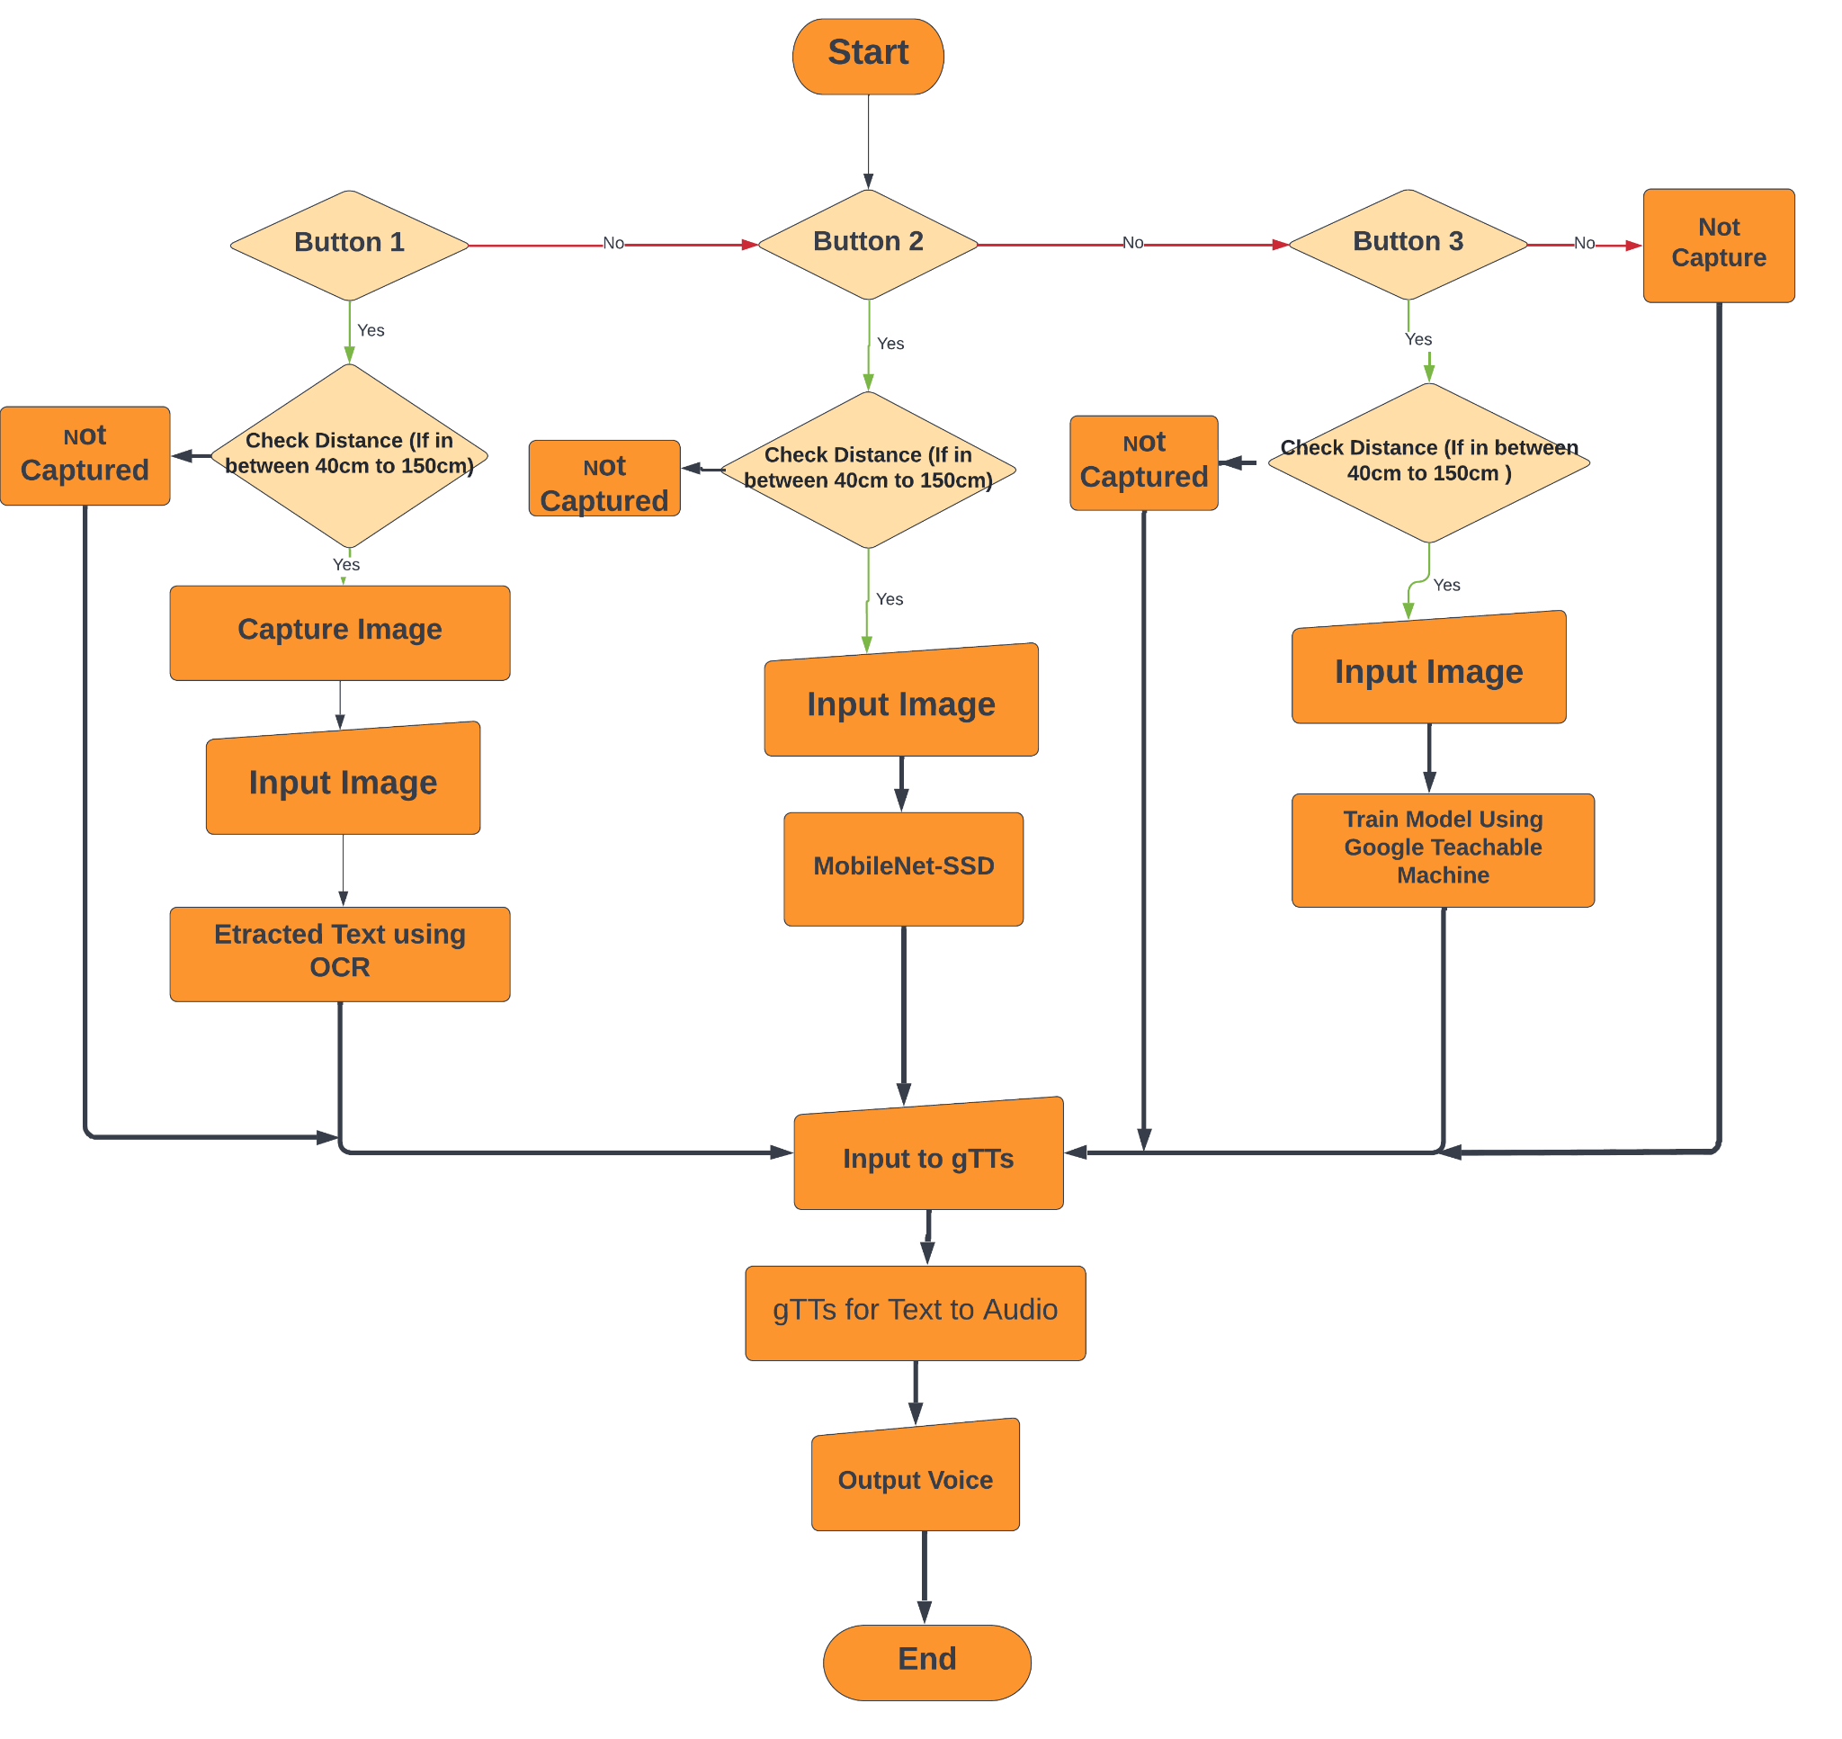

Slide 10
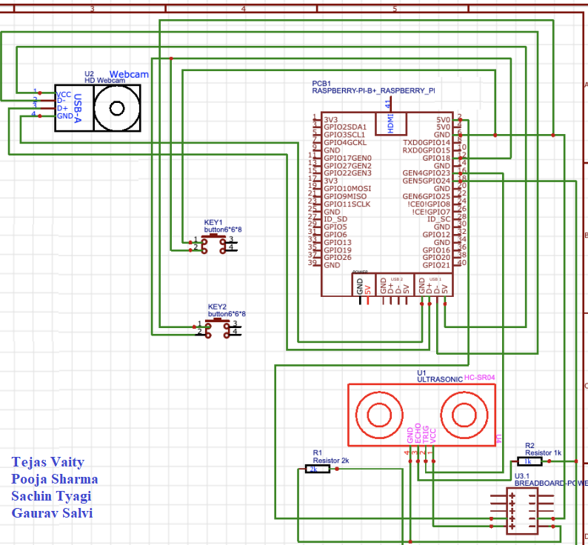
CIRCUIT DIAGRAM

Slide 11
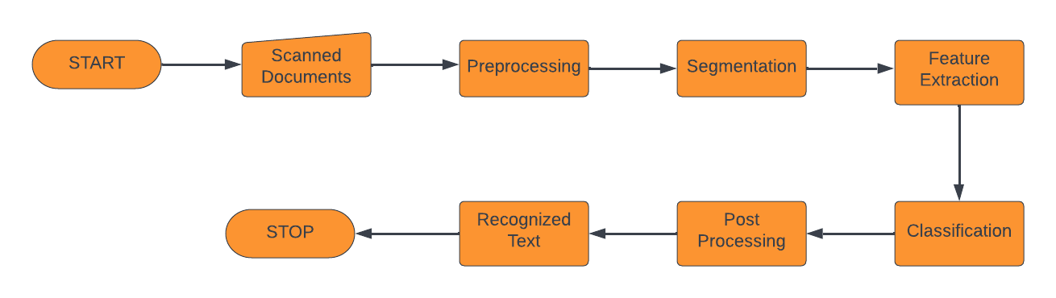
OCR TEXT MECHANISM

Slide 12
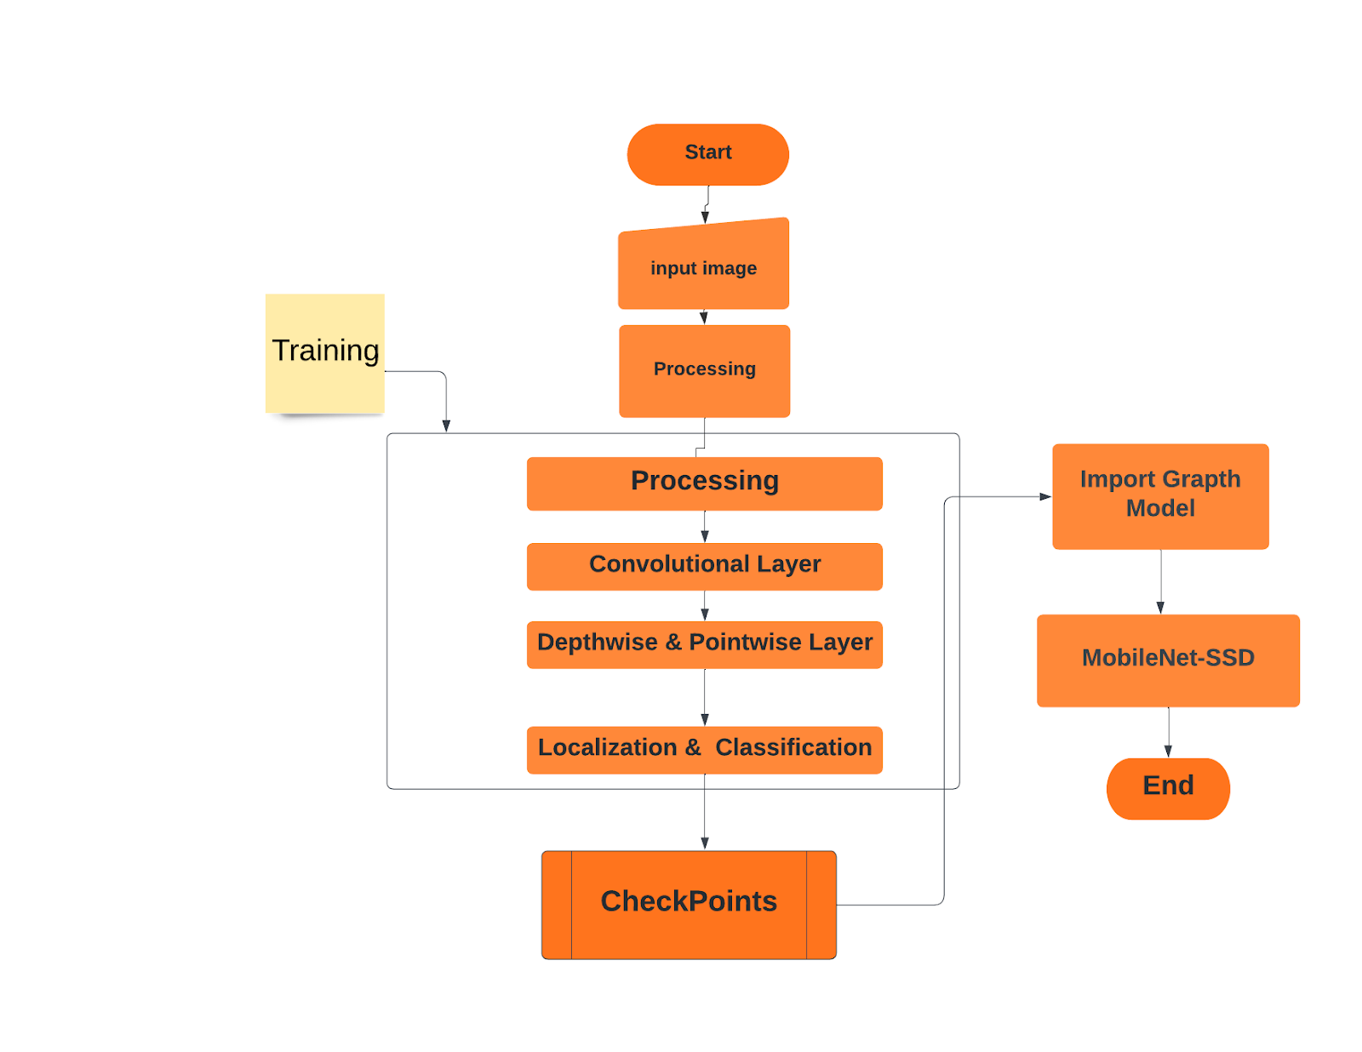
Training Flow Chart MobileNet SSD

Slide 13
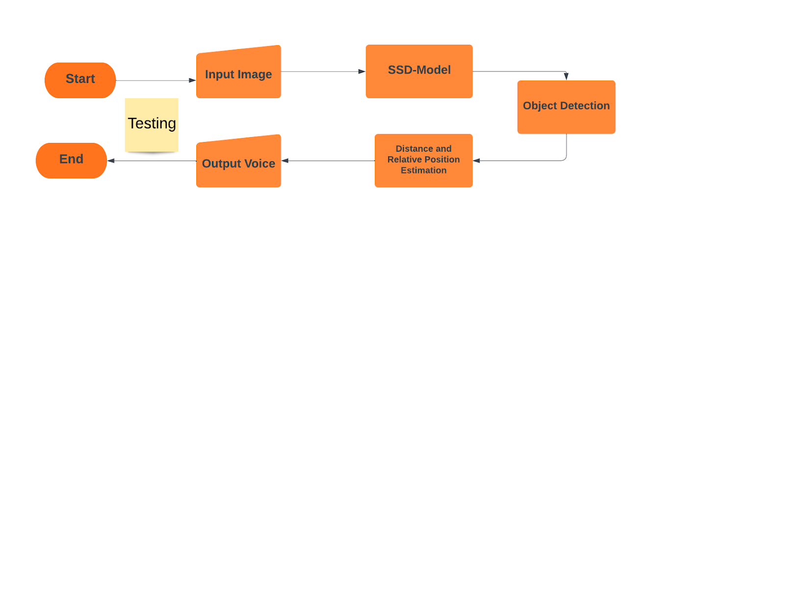
Testing Flow Chart MobileNet SSD

Slide 14
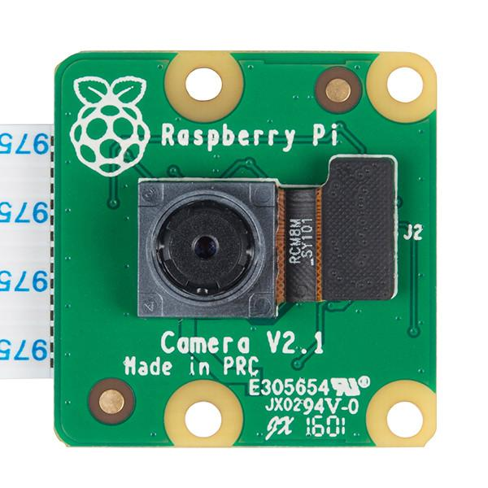
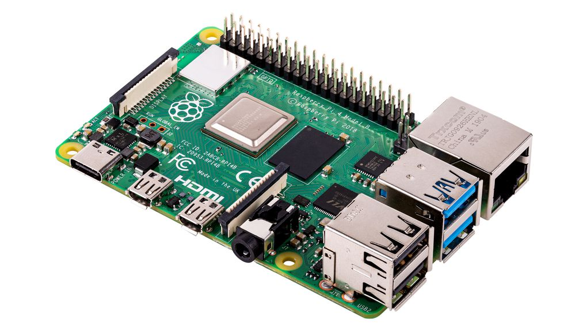
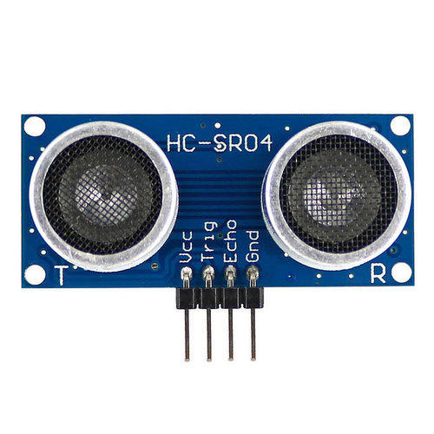
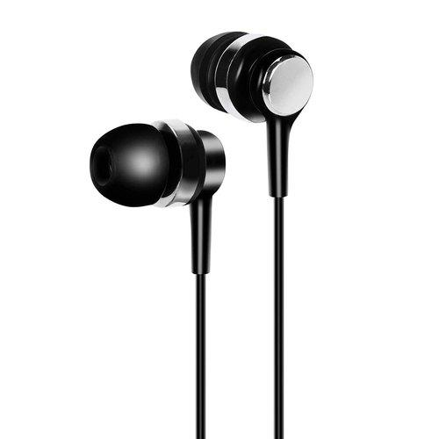
Components Required
Raspberry pi
R pi Camera
Ultrasonic Sensor
Earphones

Slide 15
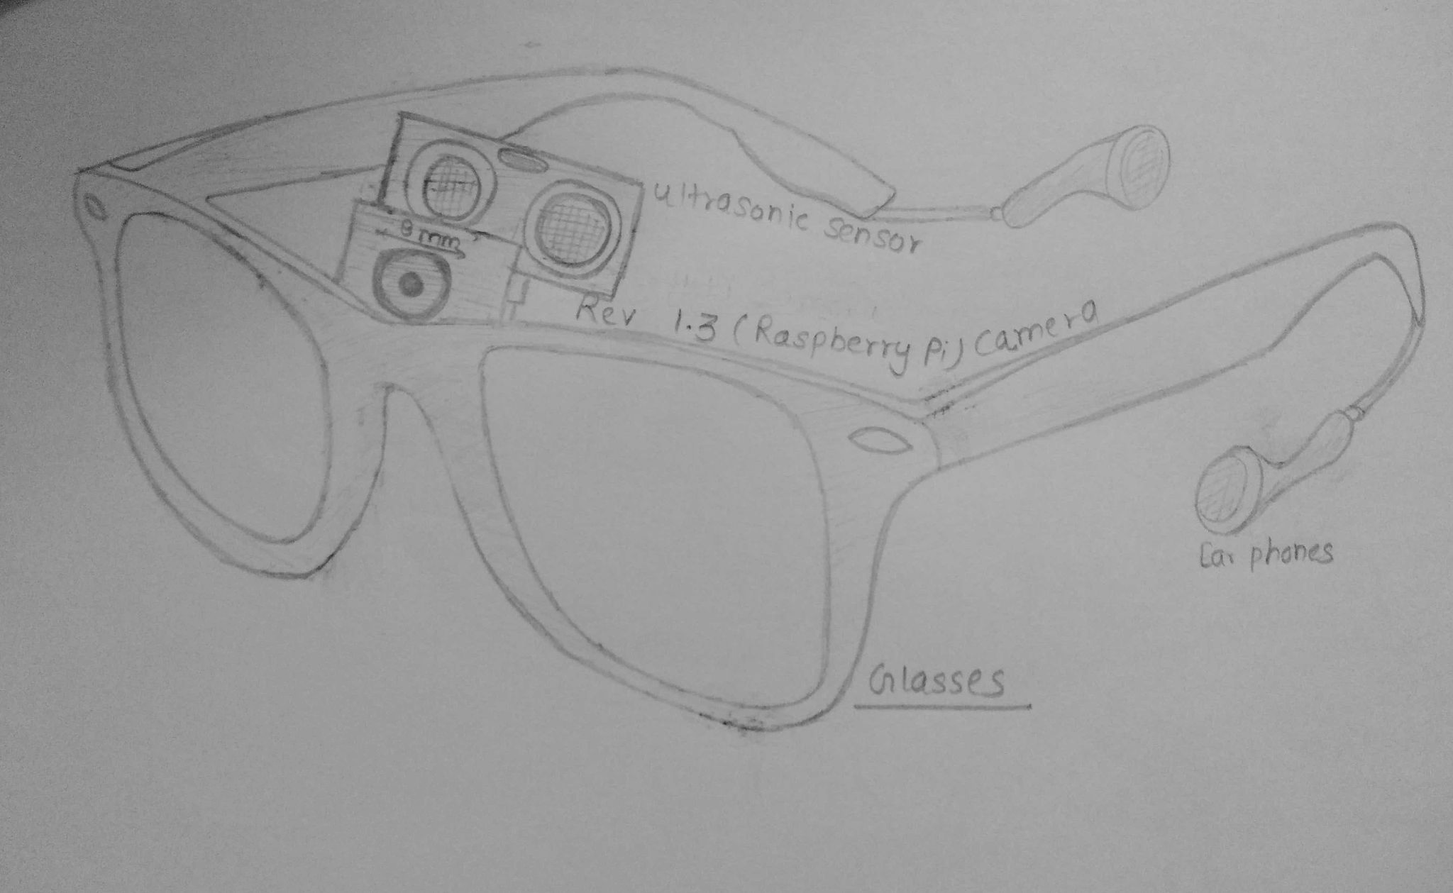
Hardware Design

Slide 16
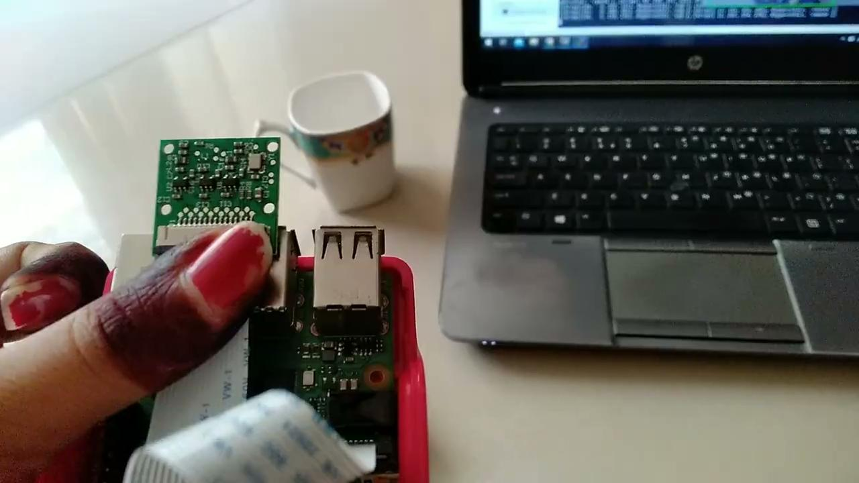
OBJECT DETECTION

Slide 17

FACE RECOGNITION

Slide 18
Market Survey
Eyesynth-Smart glasses for the Blind
by (Marcelo Alegre (Spanish Company))
1.It allows blind people to ‘feel the space’.
2.It is not verbal.
3.Costly. (€ 499 =र40,800)
4.Recognize object
Oton Glass Japanese company (Keisuke Shimakage)
1.The smart glasses are designed to help dyslexic to read.
2.It will convert text to audio
3. Not much useful for blind.

Slide 19
COST
Sr. No. | ITEMS | PRICE (in ₹)
1. | Raspberry pi 4 | 4350
2 | Ultrasonic Sensor | 80
3 | R pi Camera | 300
4 | Earphones | -
 | TOTAL | 4730

Slide 20

APPLICATIONS
1.Assist visually impaired children in receiving quality education
2.Detecting real world objects in front of users.
3. Recognizing the face of family members and trusted people.
4. Give a blind person the opportunity to listen to books, novels, newspapers,
etc.

Slide 21
Future Scope
Scene Recognition
Patient Security
Translate Multiple Language
More Powerful Algorithms for Detection
Handwriting Reading

Slide 22
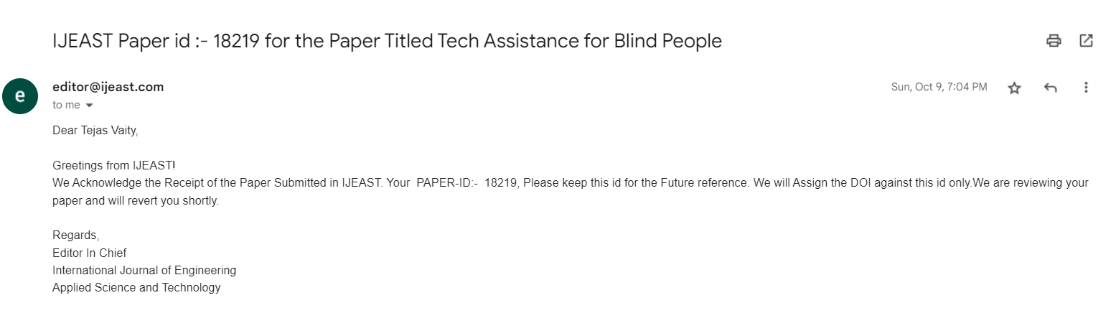
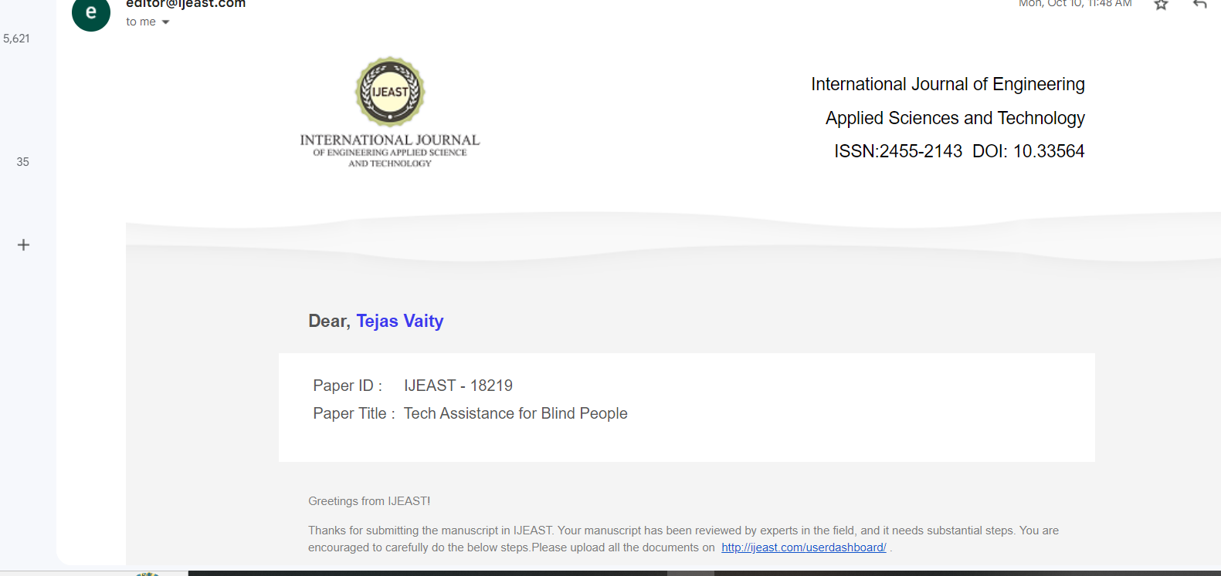
REVIEW PAPER CERTIFICATE

Slide 23

References
https://ieeexplore.ieee.org/document/5739729
https://ieeexplore.ieee.org/document/8923044/
https://ieeexplore.ieee.org/document/9156005/
Blindness and vision impairment (who.int)
https://towardsdatascience.com/read-text-from-image-with-one-line-of-python-code-c22ede074cac
For Text to Audio : https://gtts.readthedocs.io/en/latest/
https://linuxhint.com/measure_distance_raspberry_pi/#:~:text=You%20can%20measure%20distance%20using,object%20and%20get%20reflected%20back.

